Slide 1







IOT WORKLOAD CHARACTERIZATION IN NEXT GENERATION CLOUD SYSTEMS UPDATE
Supervised by: Dr. Karan Mitra, Dr. Saguna Saguna,
Dr. Christer Åhlund
Presented by: Fatema Mirza

Slide 2






Introduction
TABLE OF CONTENTS
Distribution Per day half hour only
Findings & Next steps
Distribution Per day basis only
Distribution Per day hour only
fatmir-0@student.ltu.se

Slide 3
01
Queueing Model
fatmir-0@student.ltu.se

Slide 4









Housing complex
fatmir-0@student.ltu.se 11/02/2022 | 01

Slide 5
Sensors in the Apartment
Apt#1 Total: 9 Water boiler, kitchen & bathroom motion sensor
Apt#5 Total: 9
Coffee machine, kitchen motion sensor
Apt#2
Total: 11
Kitchen motion sensor, micro
Apt#6
Total: 10
Water boiler, kitchen motion sensor
Apt#3
Total: 8
Coffee machine, kitchen motion sensor
Apt#7
Total: 11
Bathroom motion sensor, water meter
Apt#4
Total: 9
Coffee machine, micro, kitchen motion sensor
Apt#8
Total: 10
Micro, kitchen & bathroom motion sensor
fatmir-0@student.ltu.se 11/02/2022 | 02

Slide 6
02
Distribution Per day basis only
fatmir-0@student.ltu.se

Slide 7

01
02
Distribution Categories
03
Per day basis only
Per hour basis only
Per half an hour basis only
fatmir-0@student.ltu.se 11/02/2022 |03

Slide 8
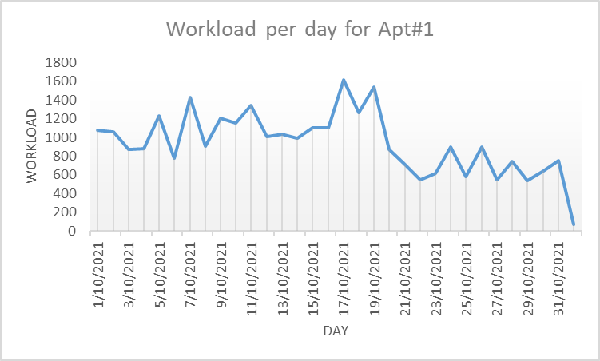
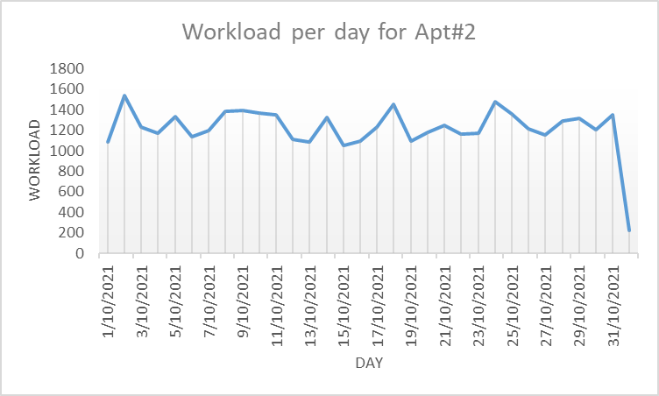
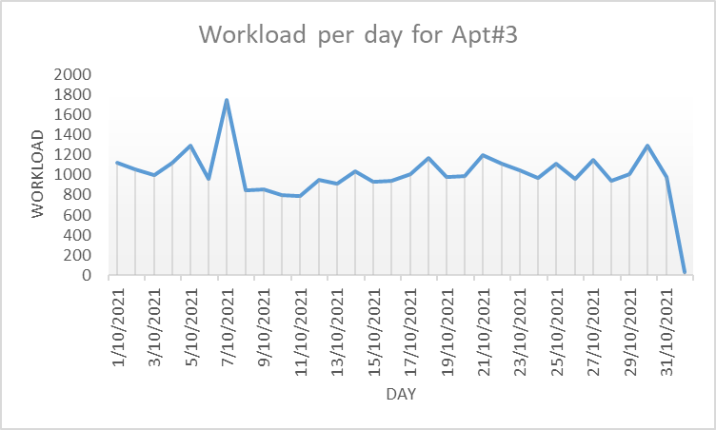
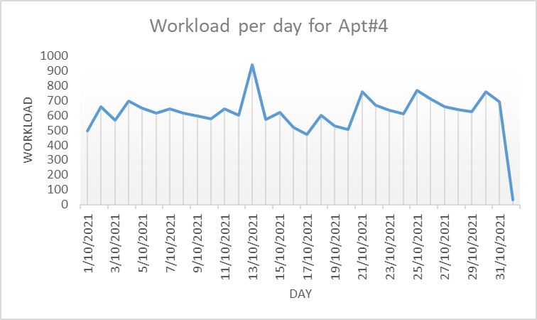
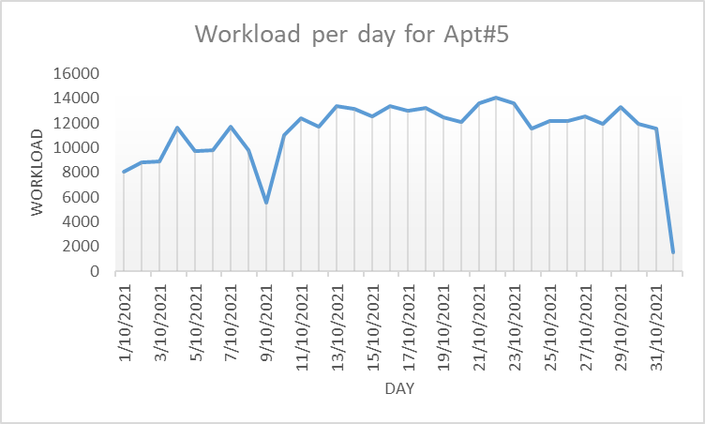
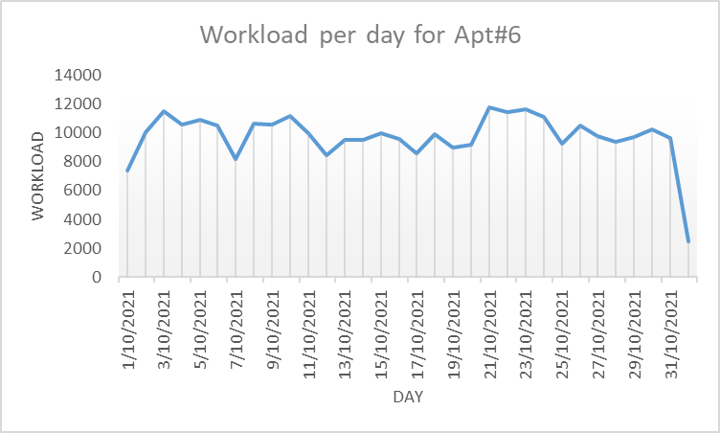
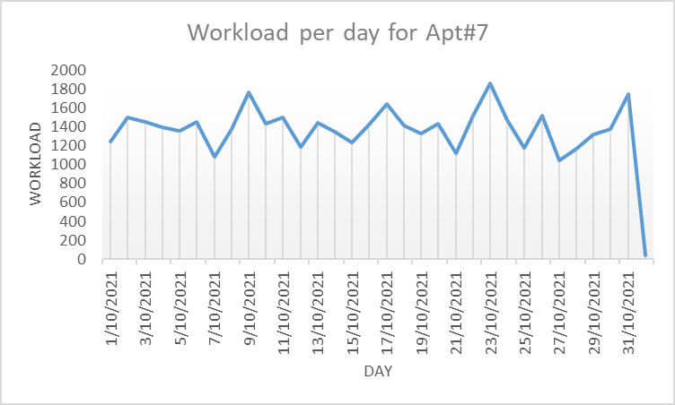
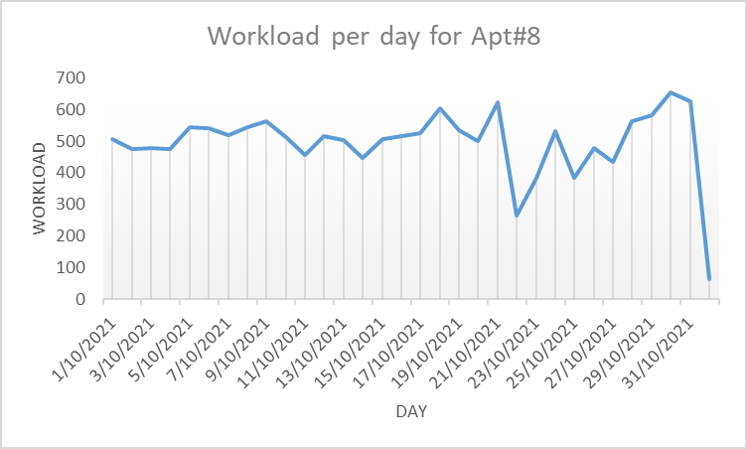
Workload per day per apartments
fatmir-0@student.ltu.se 11/02/2022 |04

Slide 9
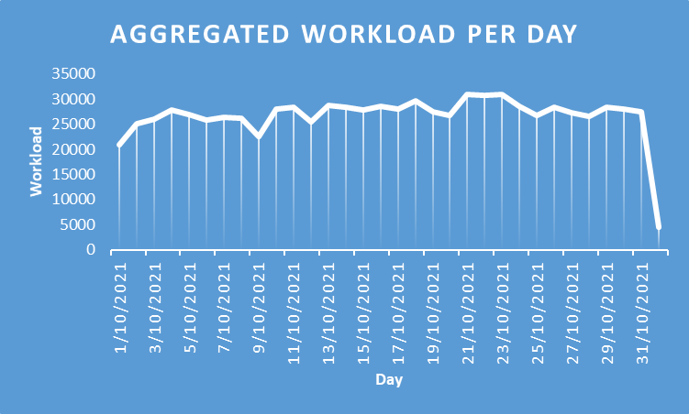
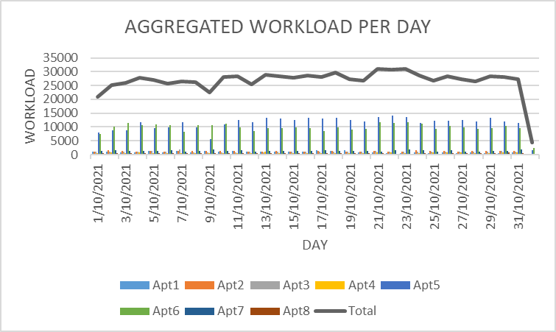
Aggregated Workload per day
fatmir-0@student.ltu.se 11/02/2022 | 05

Slide 10
03
Distribution Per hour basis only
fatmir-0@student.ltu.se

Slide 11
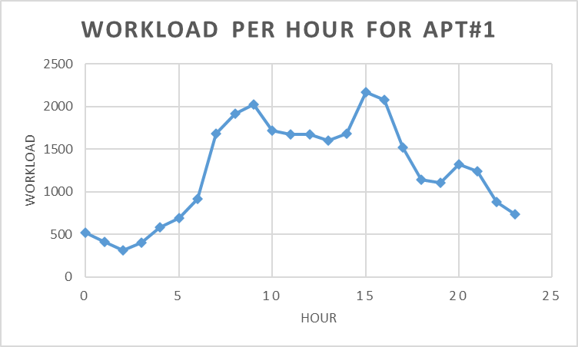
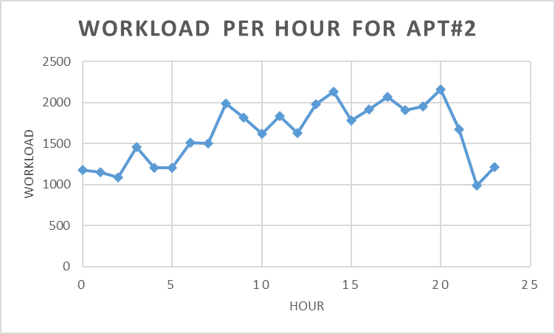
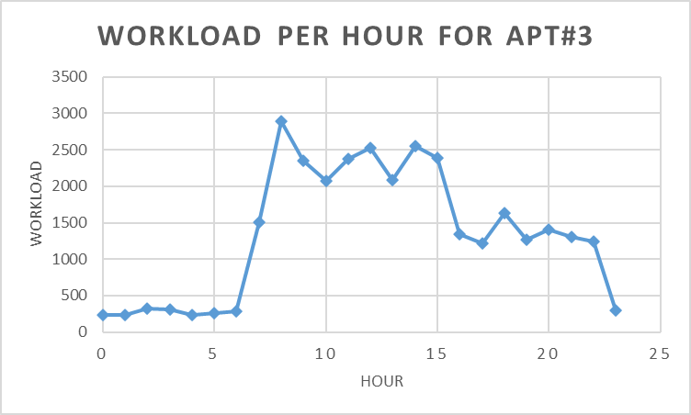
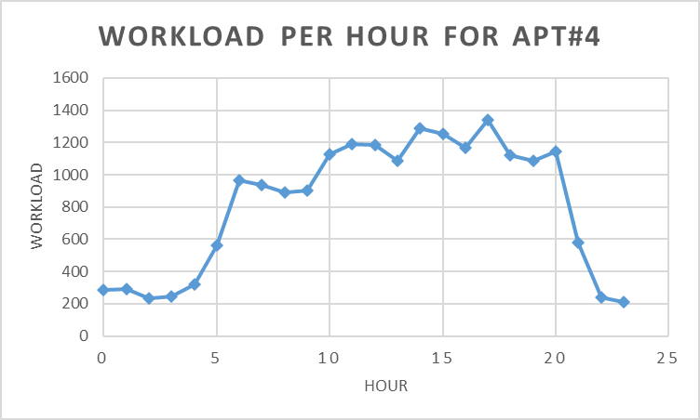
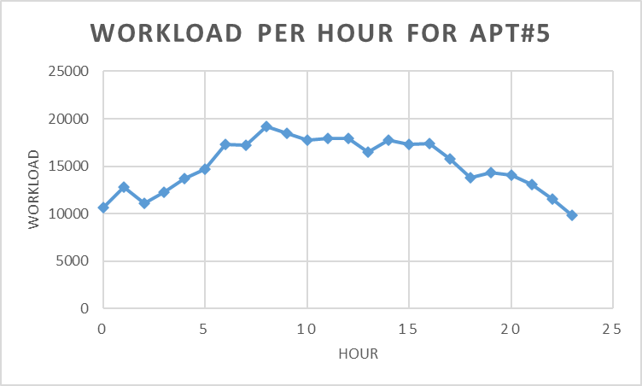
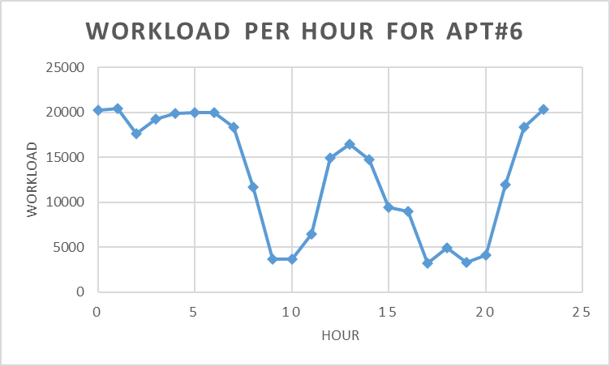
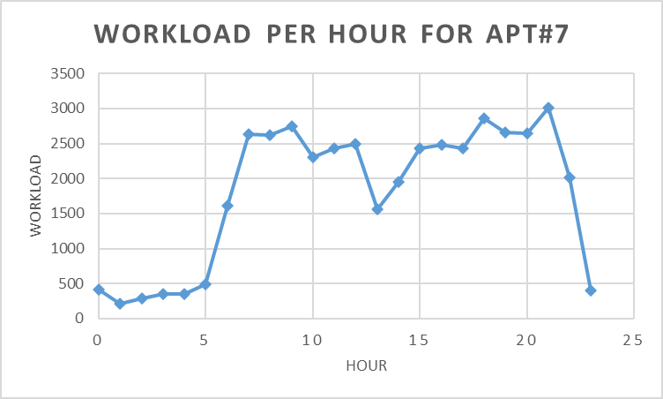
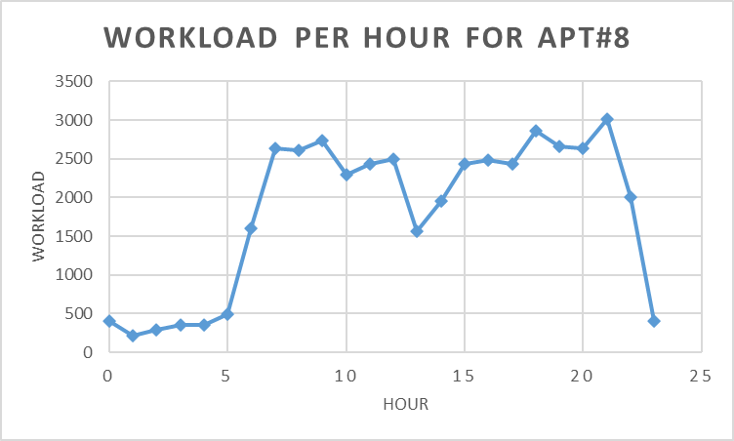
Workload per hour per apartments
fatmir-0@student.ltu.se 11/02/2022 | 06

Slide 12
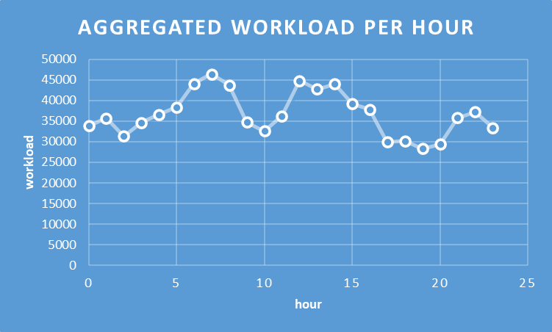
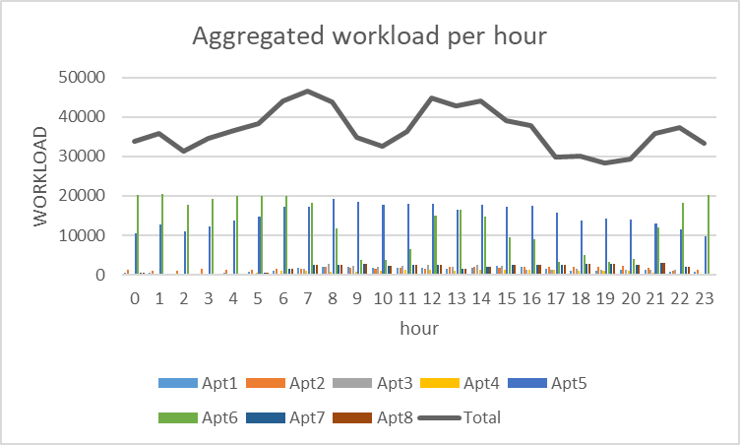
Aggregated Workload per hour
fatmir-0@student.ltu.se 11/02/2022 | 07

Slide 13
04
Distribution Per half hour basis only
fatmir-0@student.ltu.se

Slide 14
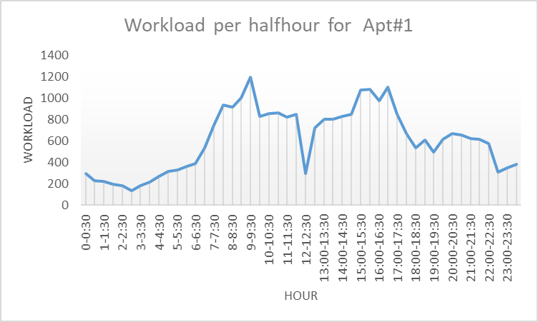
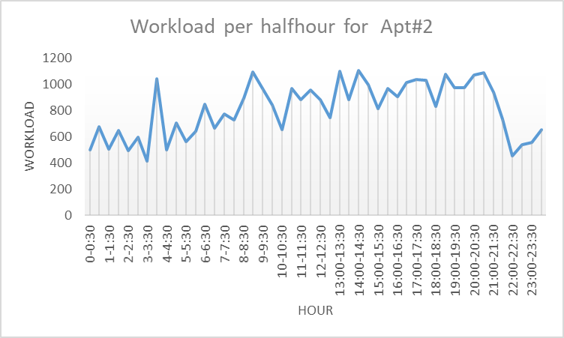
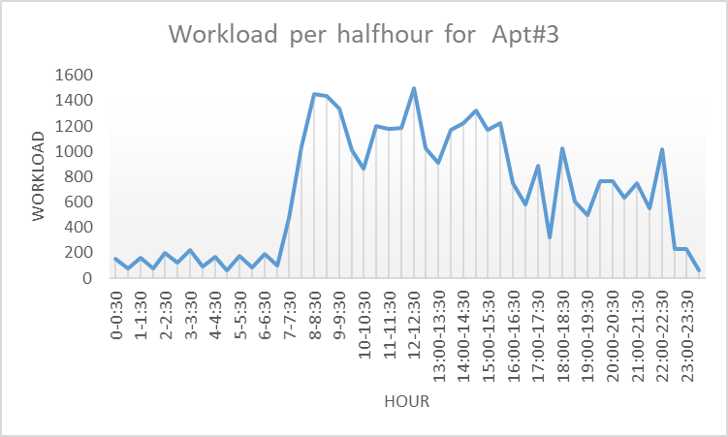
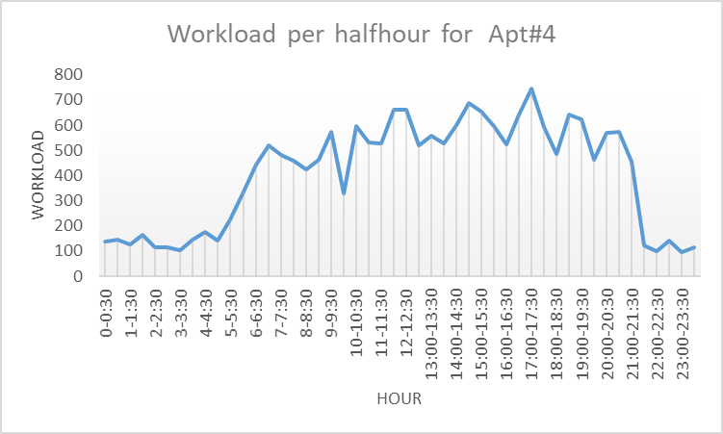
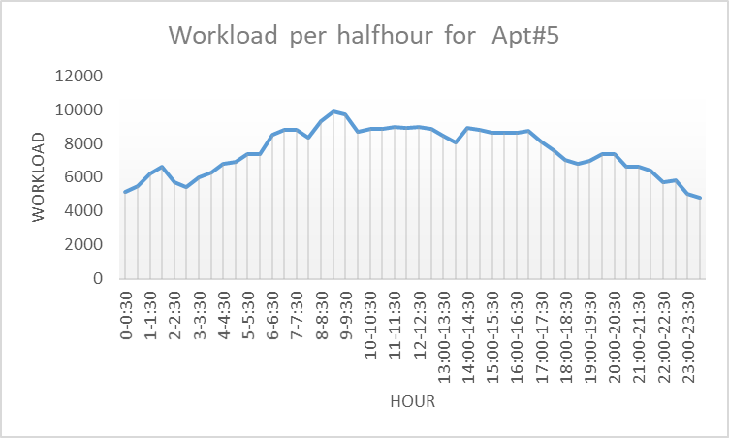
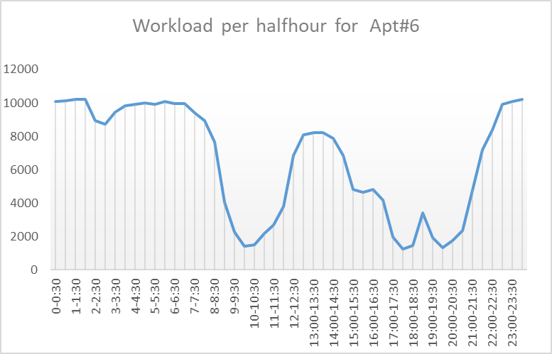
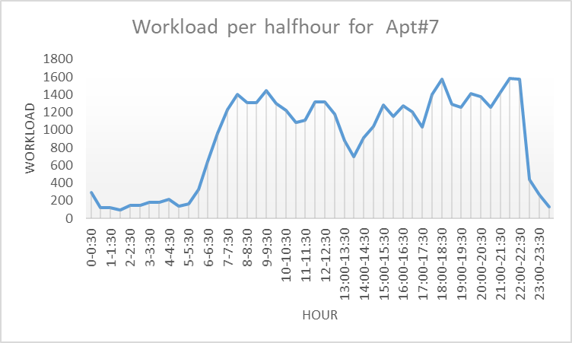
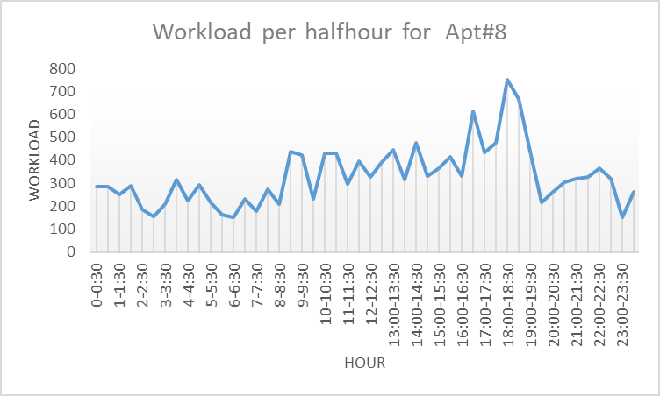
Workload per half hour per apartments
fatmir-0@student.ltu.se 11/02/2022 | 08

Slide 15
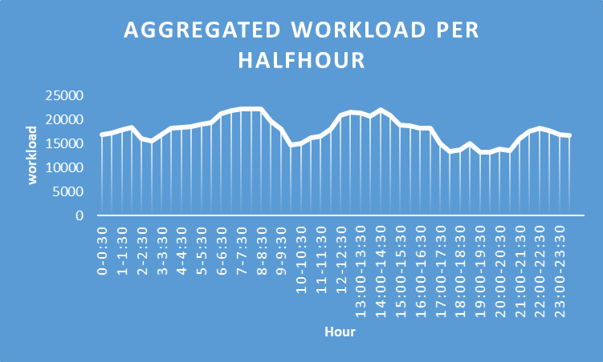
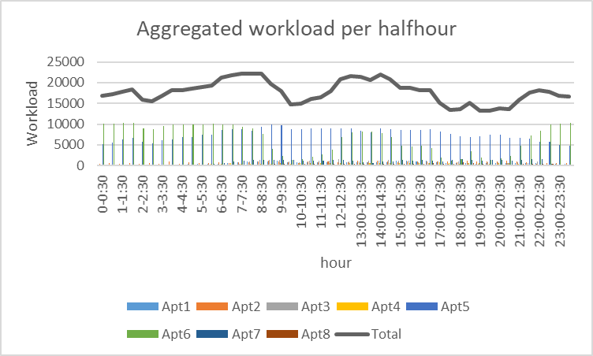
Aggregated Workload per half-hour
fatmir-0@student.ltu.se 11/02/2022 | 09

Slide 16
05
Findings
fatmir-0@student.ltu.se

Slide 17


Findings & Next steps
There is some overlap in the characteristics of the apartments (as explained during demo)
Do minute wise distribution to exploit this more
Do minute wise daily to find if weekly trends exist
Explore more about PDF and CDF (already explored that PDF is the derivative of CDF) with the dataset
Read more of Performance Modeling and
Analysis of Communication Networks^{[1]}
fatmir-0@student.ltu.se 11/02/2022 | 10

Slide 18

Thank you! Tack så mycket
Any Questions?
fatmir-0@student.ltu.se

Slide 19
02
Queueing Model for IoT-Cloud for Markov Model
fatmir-0@student.ltu.se

Slide 20
References
[1] https://www.youtube.com/watch?v=SqSUJ0UYWMQ
[2] https://techcrunch.com/2014/11/08/littles-law-is-big-for-startups/?guccounter=1&guce_referrer=aHR0cHM6Ly93d3cuZ29vZ2xlLmNvbS8&guce_referrer_sig=AQAAAFvY4BNr5Vvu2uDhXO4VTDuLiVSsISoGSjMxJMxW1Pt6ar11_kEY1wq5aw5HlXlySpE0jUAVwaZrqBu00JlSq7EUCeucjIMrTrHpRp59P000WKfozg64v5gANPPBZ1cB1W72iB8KG7aZ9xlUhU3E68QBMT2CsMngoCUV5UZ2HcNW
[3] Konstantopoulos, T. A review of Burke’s theorem for Brownian motion. Queueing Syst 83, 1–12 (2016). https://doi.org/10.1007/s11134-016-9478-x
[4] Chen H., Yao D.D. (2001) Jackson Networks. In: Fundamentals of Queueing Networks. Stochastic Modelling and Applied Probability, vol 46. Springer, New York, NY. https://doi.org/10.1007/978-1-4757-5301-1_2
[5] M. López-Benítez, C. Majumdar and S. N. Merchant, "Aggregated Traffic Models for Real-World Data in the Internet of Things," in IEEE Wireless Communications Letters, vol. 9, no. 7, pp. 1046-1050, July 2020, doi: 10.1109/LWC.2020.2980272.
[6] M. López-Benítez, C. Majumdar and S. N. Merchant, "Aggregated Traffic Models for Real-World Data in the Internet of Things," in IEEE Wireless Communications Letters, vol. 9, no. 7, pp. 1046-1050, July 2020, doi: 10.1109/LWC.2020.2980272.
[7] ing Yuan, Yu Zheng, Chengyang Zhang, Wenlei Xie, Xing Xie, Guangzhong Sun, and Yan Huang. Tdrive: driving directions based on taxi trajectories. In Proceedings of the 18th SIGSPATIAL International
Conference on Advances in Geographic Information Systems, GIS ’10, pages 99{108, New York, NY, USA,
2010. ACM.
[8] Huang, Jiwei & Li, Songyuan & Chen, Ying & Chen, Junliang. (2018). Performance modelling and analysis for IoT services. International Journal of Web and Grid Services. 14. 146. 10.1504/IJWGS.2018.090742.
[9] Tran-Gia, Phuoc & Hossfeld, Tobias (2021). Performance Modeling and Analysis of Communication Networks
- A Lecture Note. Würzburg University Press. https://doi.org/10.25972/WUP-978-3-95826-153-2
fatmir-0@student.ltu.se 11/02/2022 | 11

